Slide 1
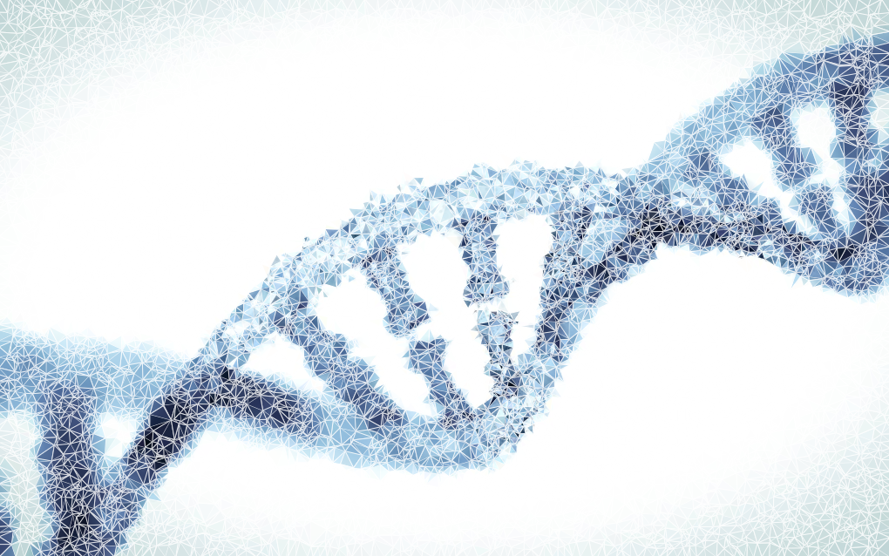
Week 1: SNPs, Heterozygosity
Human Population and Computational Genetics
(Adapted from Dr. Brenna Henn’s UCDavis Course)
Oshiomah Oyageshio
PhD Candidate

Slide 2
getting DNA
several possible tissue sources – different DNA yields
blood
widely used, preferred method
5 ml yields 50-2100 µg of DNA
requires qualified personnel
blood-borne diseases
saliva or buccal (cheek cells)
Qualified personnel are unnecessary
swabs yield <1µg of DNA
“spit-kit” yields hundreds of µg of DNA

Slide 3
What is a SNP?

Slide 4
What is a SNP?
Single Nucleotide Polymorphism: SNP
“Single Nucleotide Variant” – basically the same
SNPs are defined by their difference from the human reference genome
“SNP Arrays” are designed to assay large quantity of SNPs
Initially identified in a subset of human populations via Sanger sequencing
YRI: Yoruba, CEU: European-Americans, CHB+JPT: Chinese and Japanese
A A C G T T A T C C
Reference Genome: HG19
A A C G T T G T C C
Sample Genome

Slide 5
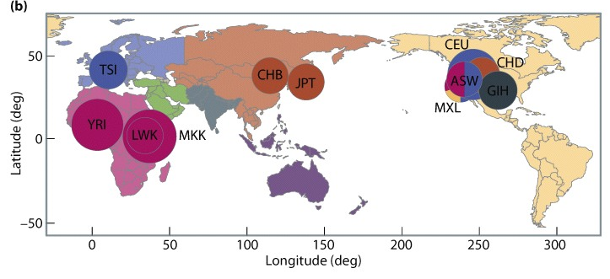
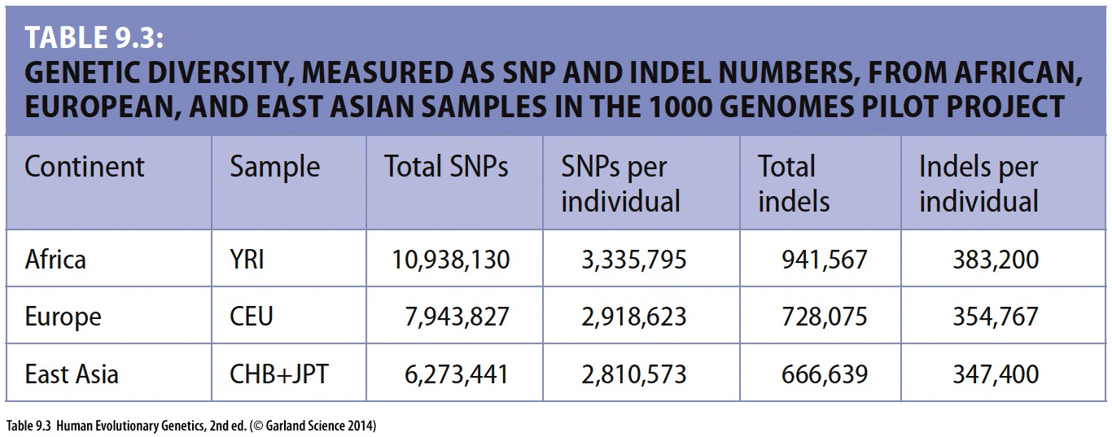

Slide 6
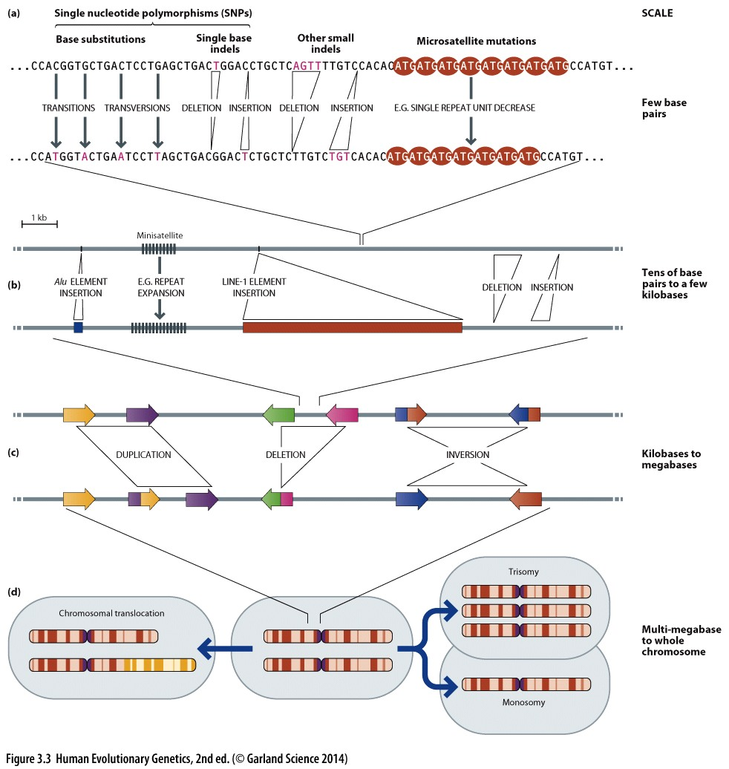
Notes:
Different classes of mutations. We’ll be focusing primarily on SNPs, STRs, and occasionally duplications. But be award there are many forms of mutation within in the human genome.

Slide 7
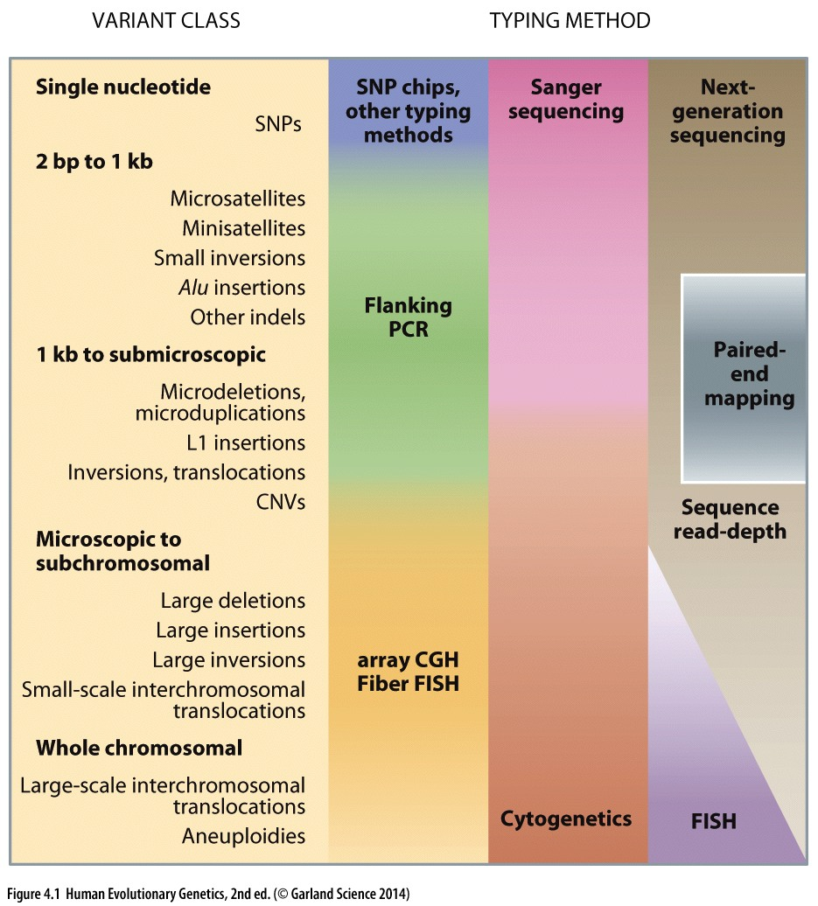
Notes:
fluorescence in situ hybridization

Slide 8
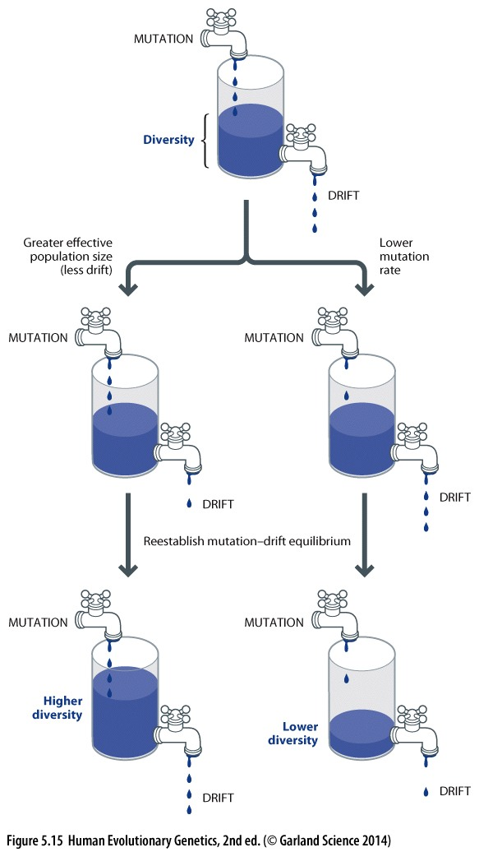
Population Genetics
What are the processes the create genetic diversity and how do patterns of genetic diversity change?
Mutation – raw source of new alleles
Migration – increases diversity by bringing in alleles from a separate population
Natural selection – changes frequency of alleles in a population
Positive selection
Purifying selection
Genetic drift – Populations are finite and hence due to random sampling of alleles from generation to generation, there can be changes in allele frequency

Slide 9
What is a Population?

Slide 10
Heterozygosity
A measure of the diversity of a polymorphic locus; for a diploid locus, the average probability that the alleles carried by an individual are different from each other.

Slide 11
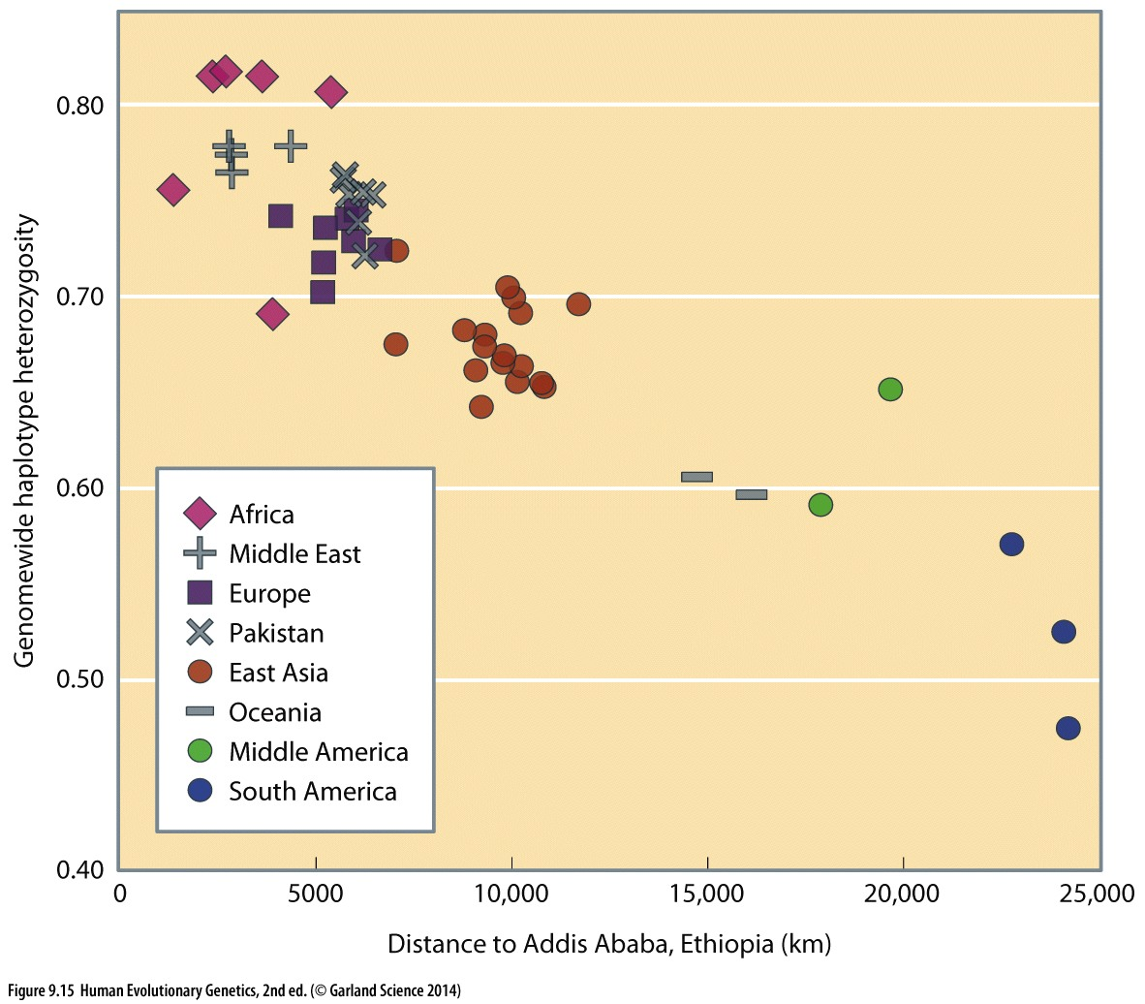

Slide 12
Heterozygosity
Correction for sample size, n
q is the number of alleles
frequency of the ith allele in a population

Slide 13
Heterozygosity (simplified)
Correction for sample size, n
q is the number of alleles
frequency of the ith allele in a population
So what is this really?
When looking at a biallelic locus, q (as in the number of alleles) = 2, so the right part of the equation simplifies to: 1 - (x_{A}²+ x_{a}²)
x_{A} and x_{a} are representing 2 different alleles

Slide 14
Drift occurs in Finite Populations
Sample alleles from the parental generation with replacement to form the new population
You can draw the same allele twice! → increase homozygosity
Change in frequency between generations will occur with a variance of p(1-p) / 2N
For a diploid population

Slide 15
If the parental population is finite, allele frequencies can change in a generation.
1 generation

Slide 16
Heterozygosity declines in a finite population
Even under random mating
Simply due to chance
Without mutation!
What would mutation do?
3.11.2 (next slide) assumes constant population size

Slide 17
Loss of Heterozygosity over Time
$$H_{t}={\left(1−\frac{1}{2N}\right)}^{t}H_{0}$$
Crow and Kimura 1970 (eq 3.11.2)
H = heterozygosity: H₀ is initial het; H_{t} is het after t generations.
t = # of generations
N = population size

Slide 18
Common PLINK Quality Control flags
Remove SNPs which are missing across many individuals –geno
$ plink --bfile mybinaryfile –-geno 0.15 –-make-bed --out cleanfile_geno015
Remove individuals missing many SNPs –mind
Remove SNPs without chromosomes
Remove SNPs failing Hardy-Weinberg
Remove low frequency alleles --maf

Slide 19
SNP Arrays
SNP Arrays
Only 2 genotype classes!
Aim is to call 3 genotypes (AA=0, AB=1, BB=2)
Occasionally, clusters are poorly identified
Notes:
Vast majority of the ‘genome-wide’ datasets are from SNP arrays. Will take years for NGS to catch up. SNP arrays started to be commonly used around 2005 after HapMap was initiated.
Just to give you a sense of the rapid change in human genetics. I started my PhD in 2003. At that time we were assaying SNPs by Sanger, sequencing the HVR of the mtDNA. Within a few years, that was outdated. Needed to do complete mtDNA by Sanger. Then by the end of my PhD things had transitioned to SNP chips (300,000+ polymorphisms). First 2 years of my postdoc we worked on SNP chips. Then jumped to low coverage genome sequencing. Now scaled back to exome sequencing. People literally used to publish their data in the journal in big tables. Now you need a computer cluster and UNIX coding skills just to do download and do simple data manipulations.

Slide 20
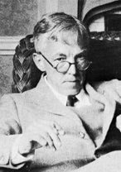
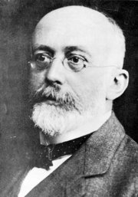
Hardy Weinberg
1908 Hardy Weinberg principle described
G. H. Hardy
W. Weinberg
How are the genotype frequencies inherited?

Slide 21
Hardy-Weinberg Equilibrium
Describes the relationship between allele frequencies (p, q) and genotype frequencies (AA, Aa, aa) in a randomly mating population.
Has certain assumptions about the population for the equilibrium to be valid.
Violation of HWE suggests that these model assumption(s) are broken.

Slide 22
Hardy-Weinberg Equilibrium
p² + 2pq + q² = 1
p and q are allele frequencies, so p + q = 1
p², q², and 2pq are genotype frequencies

Slide 23
Hardy Weinberg Framework
Assumptions
Randomly mating
Infinitely large
Diploid
No overlap between generations
Disrupting factors
(strong) Selection
Mutation
Migration
Substructure
The Hardy Weinberg principle allows us to build a null hypothesis on the distribution of allele and genotype frequencies in the population, and determine which variants deviate from that principle and which are the disrupting factors causing this behavior.
Notes:
Random mating: everyone has the same probability of contributing to next generation

Slide 24
Hardy-Weinberg Principle I
Diploid Population at Generation: G₀
Male
Female
AA homozygotes major allele
Aa heterozygotes
aa homozygotes minor allele
Genotype Frequencies
p(AA) = p²
p(Aa) = 2pq
p(aa) = q²
Allele Frequencies
p(A) = p
p(a) = q
G₀ Variant with 2 alleles:
A and a

Slide 25
Hardy-Weinberg Principle II
G₁Genotype Frequencies
p(AA) = p²
p(Aa) = 2pq
p(aa) = q²
Which are the expected genotype frequencies in G₁?
p
q
P1 | P2 | Offspring
AA | AA | AA | AA | AA | AA
AA | Aa | AA | Aa | AA | Aa
AA | aa | Aa | Aa | Aa | Aa
Aa | AA | AA | AA | aA | aA
Aa | Aa | AA | Aa | aA | aa
Aa | aa | Aa | aa | Aa | aa
aa | AA | aA | aA | aA | aA
aa | Aa | aA | aa | aA | aa
aa | aa | aa | aa | aa | aa
p²
pq
p
pq
q²
q

Slide 26
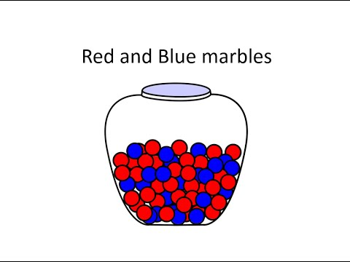
Probability
“AND” rule (multiply)
“OR” rule (sum)
P(red) = ?
Picking 2 marbles:
Red then Blue = P(red)*P(blue) = ?
100 marbles total:
60 red, 40 blue

Slide 27
Probability → Genotypes
Picking 2 marbles (all options):
Red AND Red = P(red)*P(red) = p²
OR
Red AND Blue = P(red)*P(blue)
OR
Blue AND Red = P(red)*P(blue)
OR
Blue AND Blue = P(blue)*P(blue) = q²
How to get one red and one blue? = pq OR qp → These are the SAME, so = 2pq

Slide 28
Probability → Genotypes
Picking 2 marbles (all options) = All possible genotypes in a population
Red AND Red = P(red)*P(red) = p²
OR
Red AND Blue = P(red)*P(blue)
OR
Blue AND Red = P(red)*P(blue)
OR
Blue AND Blue = P(blue)*P(blue) = q²
= p² + 2pq + q² = 1
= pq + qp = 2pq
No other genotype options (i.e. MUST be one of these 3!) so probability is 100% (=1)

Slide 29
Hardy-Weinberg Principle II
G₁Genotype Frequencies
p(AA) = p²
p(Aa) = 2pq
p(aa) = q²
Which are the expected genotype frequencies in G₁?
p
q
P1 | P2 | Offspring
AA | AA | AA | AA | AA | AA
AA | Aa | AA | Aa | AA | Aa
AA | aa | Aa | Aa | Aa | Aa
Aa | AA | AA | AA | aA | aA
Aa | Aa | AA | Aa | aA | aa
Aa | aa | Aa | aa | Aa | aa
aa | AA | aA | aA | aA | aA
aa | Aa | aA | aa | aA | aa
aa | aa | aa | aa | aa | aa
p²
pq
p
pq
q²
q

Slide 30
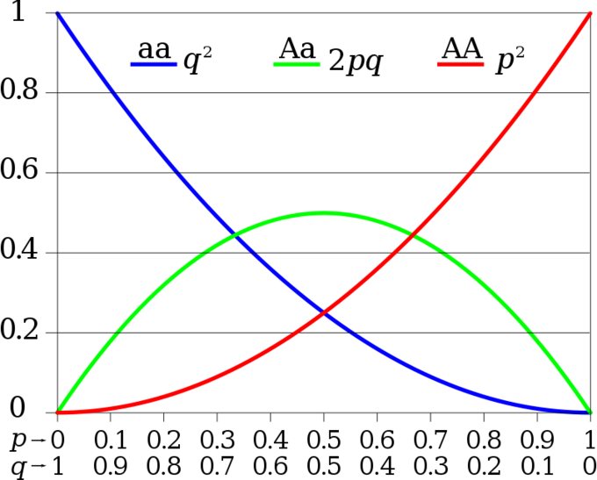
Allele & Genotype Frequencies
The x-axis shows the two allele frequencies p and q
The vertical axis shows the expected genotype frequencies.
Each line shows one of the three possible genotypes.

Slide 31
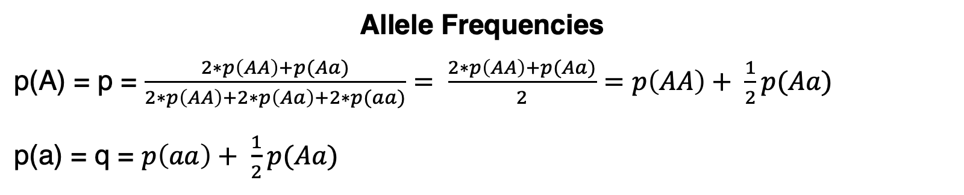
Hardy-Weinberg Principle
Genotype Frequencies
p(AA) = p²
p(Aa) = 2pq
p(aa) = q²
G₁ Frequencies
Allele Frequencies
p(A) = p = $\frac{2∗p\left(AA\right)+p(Aa)}{2∗p\left(AA\right)+2∗p\left(Aa\right)+2∗p(aa)}= \frac{2∗p\left(AA\right)+p(Aa)}{2}=p\left(AA\right)+ \frac{1}{2}p(Aa)$
p(a) = q = $p\left(aa\right)+ \frac{1}{2}p(Aa)$

Slide 32
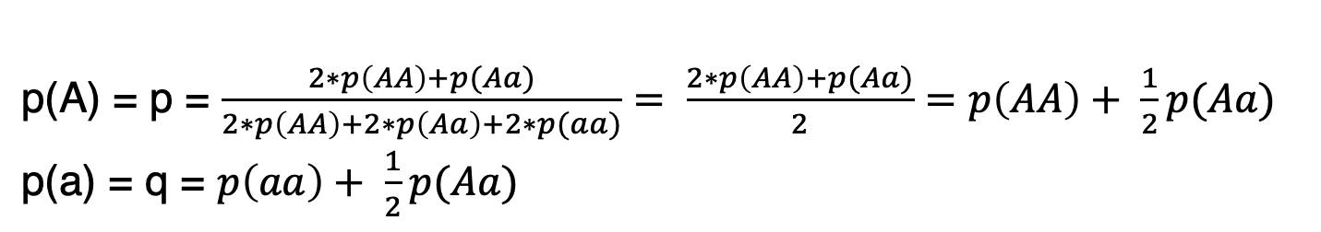
Example: genotype counts → allele frequencies
You sample 100 people and obtain the following genotype counts:
What are the frequencies of the A and a alleles?
p(A) = [(2*17)+73] / 200 = 0.535
p(a) = 1- 0.535 = 0.465
AA | 17
Aa | 73
aa | 10
p(A) = p = $\frac{2∗p\left(AA\right)+p(Aa)}{2∗p\left(AA\right)+2∗p\left(Aa\right)+2∗p(aa)}= \frac{2∗p\left(AA\right)+p(Aa)}{2}=p\left(AA\right)+ \frac{1}{2}p(Aa)$
p(a) = q = $p\left(aa\right)+ \frac{1}{2}p(Aa)$

Slide 33
Test a violation from HWE
How do we know if genotypes at a locus in a population significantly deviate from what we would expect under HWE?
We use a goodness-of-fit test (statistically null hypothesis testing): Chi-square test
Calculate chi-square stat as

Slide 34
Significance test Hardy Weinberg I
How do we test if a variant is in Hardy Weinberg Equilibrium?
Working example
Two populations are studied, X and Z with a sample size of 100 individuals each. The allele frequencies of a given variant are the same, p = p(A) = 0.8 and q = p(a) = 0.2.
However, the genotype frequencies are different.
p(A) = 0.8; p(a) = 0.2
N = 100
OBS | Population X | Population Z
AA | 70 | 62
Aa | 20 | 36
aa | 10 | 2

Slide 35
Significance test Hardy Weinberg II
1. Calculate the EXPECTED genotype frequencies under Hardy Weinberg
p(A) = 0.8; p(a) = 0.2
N = 100
OBS | Population X | Population Z
AA | 70 | 62
Aa | 20 | 36
aa | 10 | 2
Genotype | p() × N | Expectation
AA | p² × N | 0.8² × 100 = 64
Aa | 2pq × N | 2(0.8)(0.2) × 100 = 32
aa | q² × N | 0.2² × 100 = 4
2. Apply Chi-Squared significance test
AA
Aa
aa
Pop X:
Online chi-squared table
p-value = 0.05, 1 df = 3.84
p-value = 0.01, 1 df = 6.63
Pop Z:

Slide 36
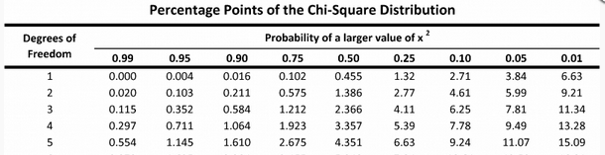
Interpret Chi-Squared (X²) Result
Looking up the Χ² table (a standard quantile – probability table)
p-values
AA
Aa
aa
Pop X:
Χ² > 3.84 → p < 0.05
Pop Z:
Χ² < 3.84 → p > 0.05

Slide 37
Deviations from Hardy Weinberg
Assumptions
Randomly mating
Infinitely large
Diploid
No overlap between generations
Disrupting factors
(strong) Selection
Mutation
Migration
Substructure
Deviations from random mating include inbreeding and assortative mating. Both special cases of population structure.
Examples?
Notes:
Random mating: everyone has the same probability of contributing to next generation

Slide 38
Population size I
No real population is infinitely large.
Each generation represents a finite sample from the previous one.
Assuming no migration, no selection, and constant population size over generations, variation in allele frequency between generations can occur solely through this stochastic process of sampling.
Assumptions
Randomly mating
Infinitely large population
Diploid

Slide 39
HWE Disrupting factors I
Assumptions
Randomly mating
Infinitely large
Diploid
No overlap between generations
Disrupting factors
(strong) Selection
Mutation
Migration
Substructure

Slide 40

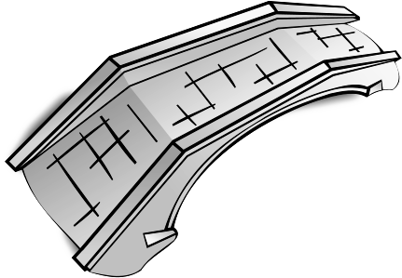
Migration 1
Population Structure
What other factors might cause structure?

Slide 41
Migration II
What happens when we have migration (e.g. admixture)?
p = 0.6 q=0.4
p = 0.8 q=0.2
Population X in HWE
Population Z in HWE
Migrants from PopB
Migration disrupts Hardy Weinberg Equilibrium, including new genotypes at different frequencies.
Gene flow vs. population structure

Slide 42
Migration III
p = 0.6 q=0.4
p = 0.8 q=0.2
Population X in HWE
Population Z in HWE
Migrants from PopB
When migrants move into a new population, in the next generation they will choose mates from the new group.
If each parent is homozygous for a different allele, then all of their children will be heterozygous.
The population is not at equilibrium.
Male
Female
AA homozygotes major allele
Aa heterozygotes
aa homozygotes minor allele

Slide 43
Migration III
p = 0.6 q=0.4
p = 0.8 q=0.2
Population X in HWE
Population Z in HWE
Migrants from PopB
If a single episode of migration occurs, the first generation has many heterozygotes.
After a second generation of random mating, genotype frequencies return to HWE.
Thus, if we observe an excess of heterozygotes recent migration has taken place, or is ongoing.
Male
Female
AA homozygotes major allele
Aa heterozygotes
aa homozygotes minor allele

Slide 44
Migration IV
The Wahlund Effect: Deficiency in Heterozygotes due to Sub-Structure
Population X
Let’s say we sample a population and calculate the genotype frequencies.
We expect:
p² = 0.6² = 0.36 → AA
2pq = 2*0.6*0.4 = 0.48 → Aa
q² = 0.4² = 0.16 → aa
We observe:
AA = 0.52
Aa = 0.10
aa = 0.38
p = 0.6 q=0.4
If there is sub-structure, we are artificially pooling two populations. These sub-populations are not mating randomly and accumulate different allele frequencies.

Slide 45
Key concepts
Hardy Weinberg Principle: If a variant is in Hardy Weinberg Equilibrium, allele and genotype frequencies will not change across generations.
Assumptions: Infinite, diploid and randomly mating population.
Disruptive factors: Selection, migration, mutation, substructure.
The significance test used to determine whether a variant is under Hardy Weinberg equilibrium is the Chi-Squared test.
Migration (sometimes referred to as admixture) will disrupt Hardy Weinberg equilibrium and eventually end up by homogenizing allele frequencies between two different populations.
Selection will disrupt Hardy Weinberg equilibrium per se. Depending on the selection forces, different effect will be detected in terms of genotype frequencies.

Slide 46
General PLINK notation Manipulating Data
$ plink --bfile mybinaryfile <DO_STUFF>
--make-bed --out <OUT_PLINK FILE>
Tells plink to make
a new binary bed file
Tells plink the name of the new file
Filter out SNPs with genotype frequencies which exceed a Hardy-Weinberg p-value
$ plink --bfile mybinaryfile --hwe 0.0001
--make-bed --out mybinaryfile_specsnps

Slide 47
Genotype Frequencies and HW
$ plink --bfile mybinaryfile <DO_STUFF> --out <OUT_ANALYSIS_FILE>
https://www.cog-genomics.org/plink/1.9/filter#hwe
https://www.cog-genomics.org/plink/1.9/basic_stats#hardy
$ plink --bfile mybinaryfile --hardy --out mybinaryfile_hwgenotypes

Slide 48
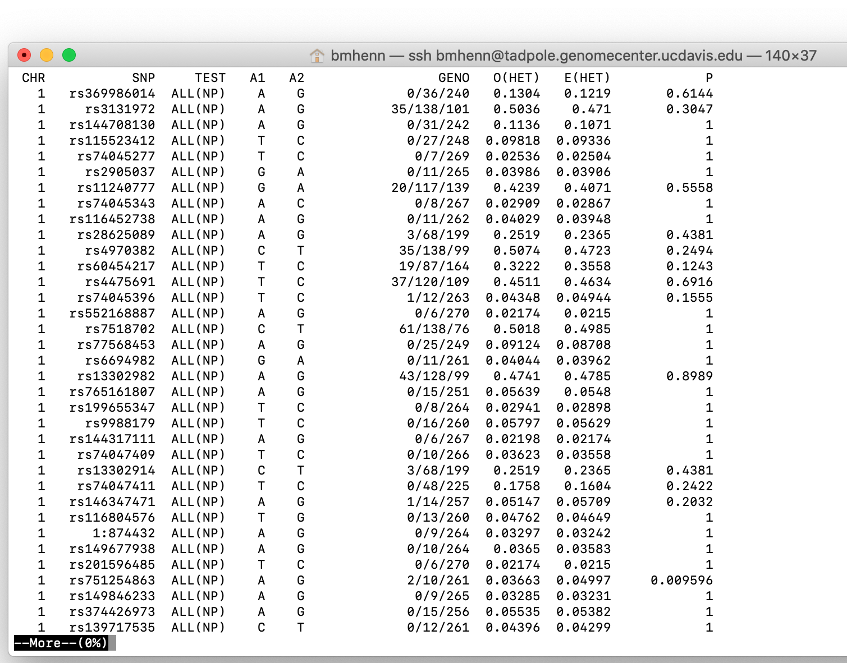
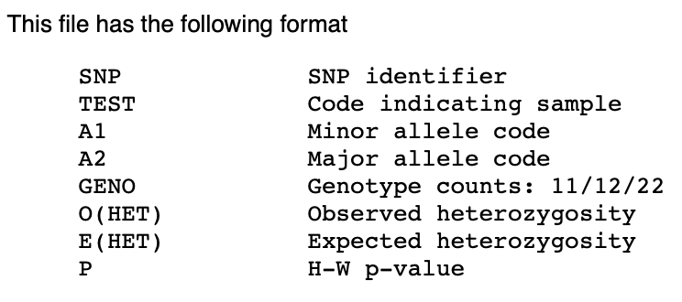
Genotype Frequencies and HW

Slide 49
An Extra Hardy-Weinberg Example

Slide 50
Example
A SNP (rs9315851) genotyped in 226 CEU individuals shows a distribution as below. Is this SNP in Hardy-Weinberg equilibrium in this population?
Genotype | Counts of individuals
CC | 124
CT | 84
TT | 18

Slide 51
Step1: calculate allele freq.
Let’s define p as freq. of C, q as freq. of T
p = (2*CC + CT ) / (2 * (CC+CT+TT)) =
(2*124 + 84) / (2 * 226) = 0.735
two ways of calculating q
1) q = 1-p = 0.265
2) q = (CT+2*TT) / 2*[(CC+CT+TT)]= 0.265

Slide 52
Step 2: calculate expected genotype counts under HWE
Under HWE, according to the p and q we have, the genotype counts are expected to be
CC%: p² = 0.54
counts: p²N = 0.54 * 226 = 121.9
CT%: 2pq = 0.39
counts: 2pqN = 0.39 * 226 = 88.1
TT%: q² = 0.07
counts: q²N = 0.07 * 226 = 15.9

Slide 53
Step 4: Χ² test
Can we reject the Null hypothesis( that they are under HW) ?
Remember:
CC: (124 – 121.9)² / 121.9 = 0.035
CT: (84 – 88.1)² / 88.1 = 0.195
TT: (18 – 15.9)² / 15.9 = 0.269
Our test statistic (Χ²) is the sum of above: 0.498978

Slide 54
Step4 : cont.
Looking up the Χ² table (a standard quantile – probability table)
Χ² < 3.84 → p > 0.05
Χ² > 3.84 → p < 0.05
Our Chi-square: 0.498978, so the p value is between 0.25 and 0.5

Slide 55
Step 5 : Give your conclusion
Since p>0.05 for the Chi-square test, the deviation of observed genotype frequency from expected one is likely to happen by chance, hence we are unable to reject Null hypothesis.
In a more simplified yet statistically less precise statement:
The genotypes are in HWE.

